Slide 1

Problem Formulation
Detection of emotions based on the region of machine learning and natural language processing areas
Emotion detection is considered as one of the most important technique in human-machine communication
To prepare a framework to detect the emotions of faces

Slide 2
Objective
The essential target of this is the programmed recognition of human sentiments
The main objective is to find and join new techniques for human emotion detection for better outcomes
Use the eye recognition phase to enhance this detection system
For the trademark extraction of face, neighborhood twofold case will be utilized

Slide 3

Emotion Recognition
Charles Darwin concluded that emotions are actually species-specific
Face plays important role in non verbal communications
Two main approaches are to measure the facial expressions
The first approach is message judgment
The second approach is sign judgment

Slide 4
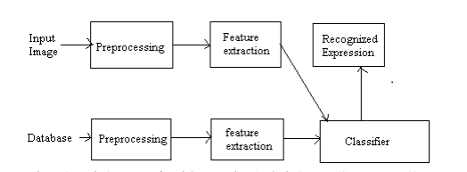
Basic Structure of Automatic Facial Expression Recognition Systems

Slide 5
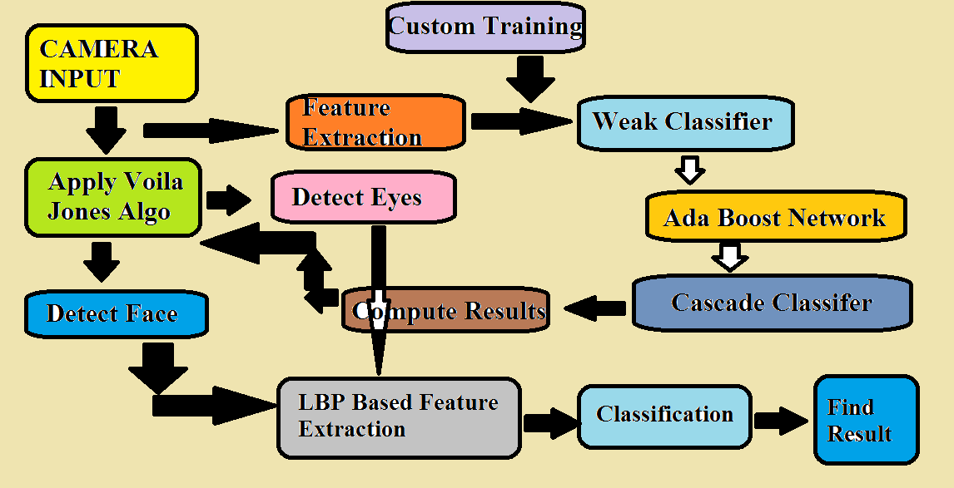
Research Methodology
Involves different phases for face emotion detection system.

Slide 6
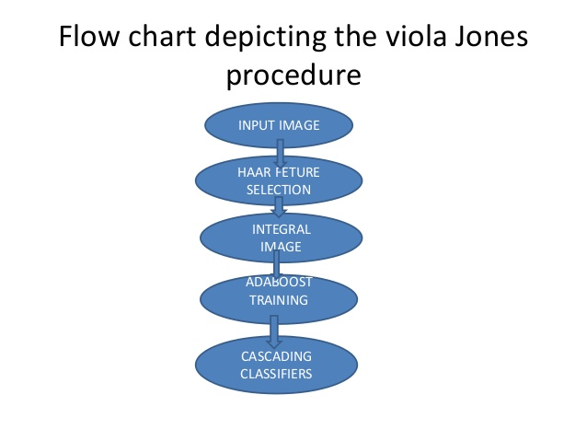
Viola Jones Algorithm for Facial Emotion Recognition System
Paul Viola and Michael Jones exhibited strategy for confront location
15 times snappier than any method with 95% precision at around 17 fps
depends on the utilization of basic Haar-like components that are assessed rapidly using another picture portrayal
In its easiest shape elements thought of as pixel power set assessments

Slide 7
Neighborhood matched case for trademark extraction
The most important property of the master of LBP in exact acquisitions is its drive to dull scale developments i.e. by illuminating blends
Hindrances in this framework is much tricky and a long town approach which we are facing now
In order to remove this issue, new methodology is proposed

Slide 8
LBP Based Feature Extraction
Events of the LBP codes in a picture are gathered into a histogram
Characterization is then performed by processing straightforward histogram similitudes
In any case, considering comparative approach for facial picture portrayal brings about lost spatial data, along these lines one ought to arrange the surface data while holding likewise their areas

Slide 9
Project Demo

Slide 10
Future Work
The feature extraction can be done by applying different algorithms such as A*, Greedy search algorithm and deep learning techniques
Based on these algorithms we compare the results of our searching algorithms applied on our project

Slide 11
Any Questions??

Slide 12
FACE EMOTION RECOGNITION
Submitted by:
Team: Cyber Blue

